Slide 1
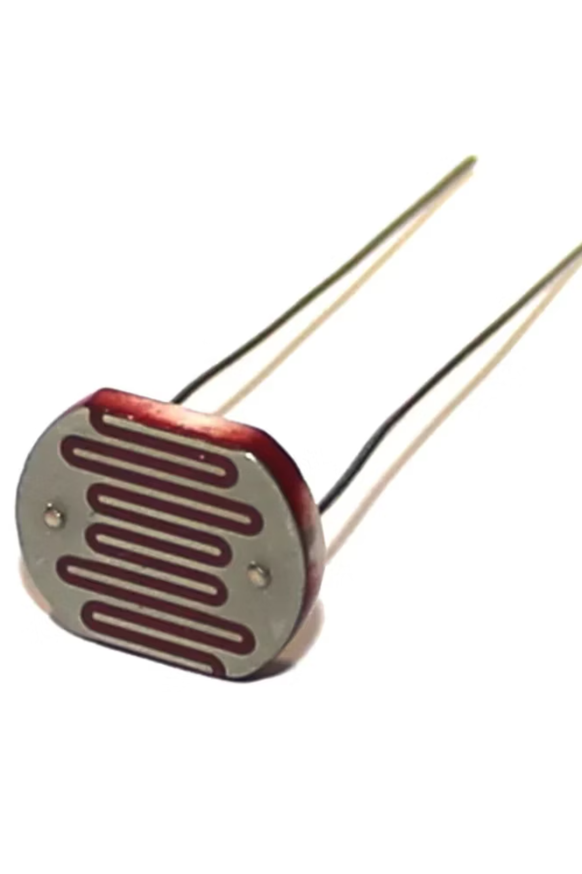


Understanding Light Dependent Resistors (LDRs)
by Aryan Choudhary

Slide 2
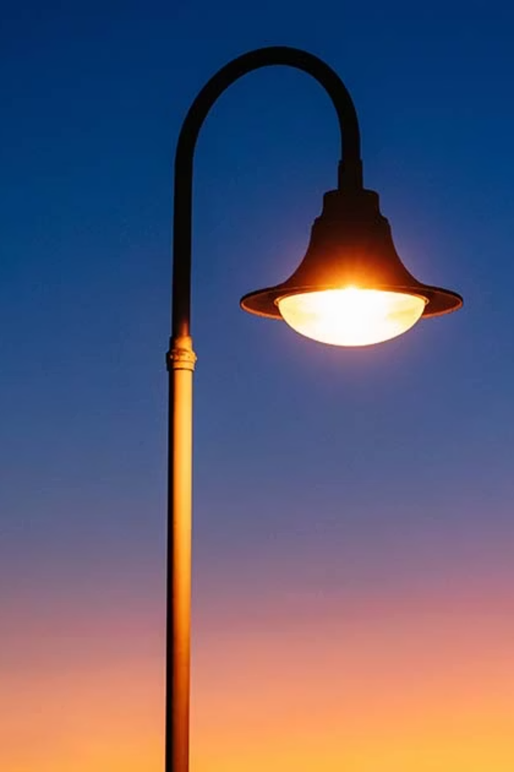
What is an LDR?
Definition
An LDR, or Photoresistor, is a resistor. Its resistance changes with light intensity. More light means less resistance.
Basic Principle
It's a semiconductor device. It uses the photoelectric effect. Light energy frees electrons. This increases conductivity.

Slide 3



How LDRs Work
Darkness
Low Light
Bright Light
In the dark, an LDR has high resistance. It blocks electric current flow.
As light increases, resistance drops. More current can pass through.
In bright light, resistance is very low. It acts almost like a wire.

Slide 4
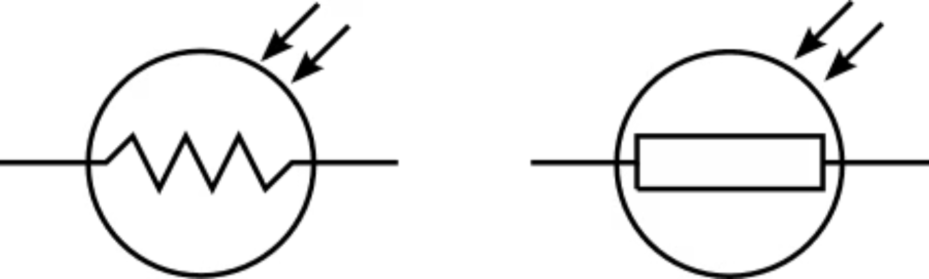
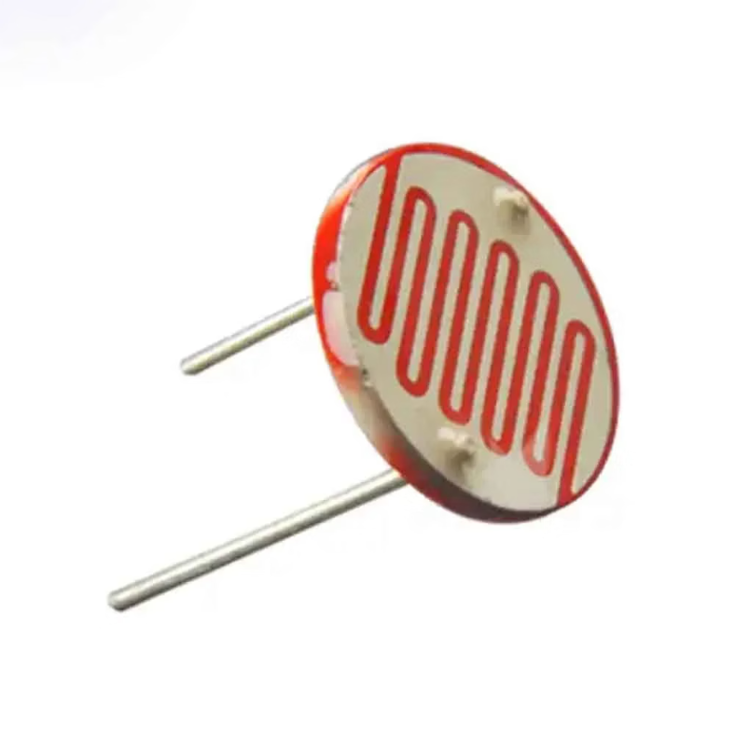
LDR Circuit Symbol and Appearance
Circuit Symbol
Real-life LDR
This is the standard symbol. The arrows show light input. It's often found in circuit diagrams.
LDRs are small, with a zigzag pattern. This pattern maximizes surface area. It helps capture more light.

Slide 5
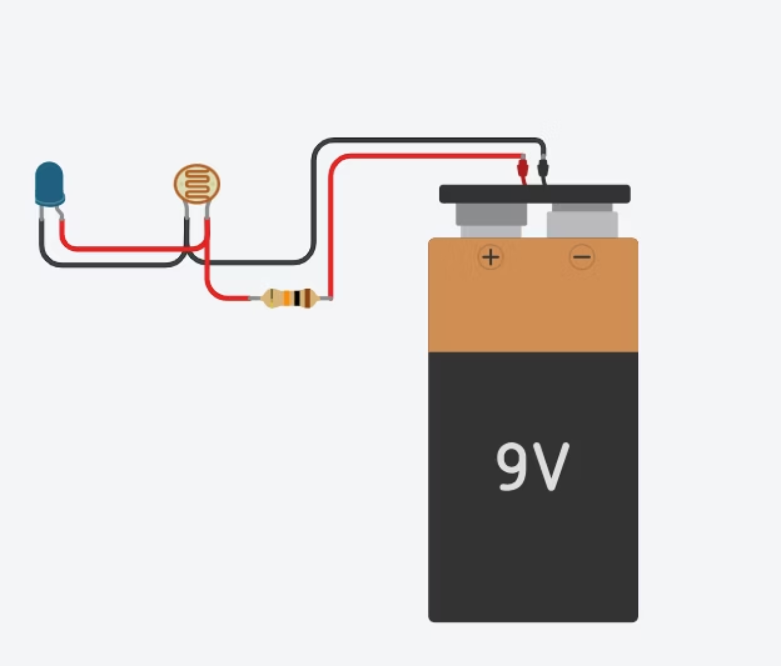
Simple LDR and LED Circuit
In this circuit, the LED lights up in the dark. When light hits the LDR, its resistance drops. This diverts current from the LED, turning it off. This shows an LDR as a light-con

